Slide 1
Jermyn Borough Council Meeting
08/21/2025

Slide 2

Meeting Agenda
AUGUST 21,2025
CALL TO ORDER
PLEDGE OF ALLEGIANCE
ROLL CALL
PREVIOUS MEETING MINUTES
TREASURE REPORT/BILLS PAYABLE
CORRESPONDENCE
SECRETARY REPORT
PUBLIC COMMENT
PROFESSIONAL REPORTS
COMMITTEE REPORTS
CODE ENFORCEMENT
DATA CENTERS
NEW BUSINESS
ADJOURNMENT

Slide 3
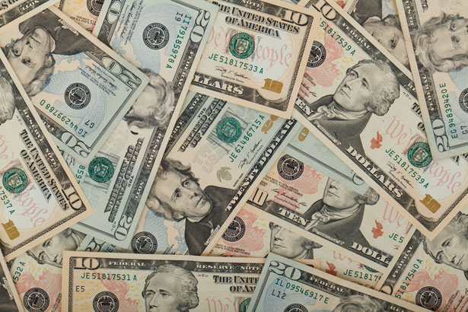
Treasurer’s report
8/1/2025
ASSETS
Checking/Savings
American Rescue Plan Fund 93,594.06
Capital Reserve - DPW 1,083.80
Capital Reserve - Police 6,679.82
Crime Watch Fund 222.69
General Fund - Community 100,610.51
General Fund - FNB 4,110.07
Holiday Lights Fund 400.59

Slide 4
Treasurer’s report
Investment - General Fund 1,149.46
Investment - Liquid Fuels 25,308.52
Investment - Paving Fund 1,161.41
Investment - Recycling 126.92
Investment - Refuse 181.00
Liquid Fuels - FNB 41,550.51
Petty Cash 194.00
Recreations Fund 30,004.33
Recycling - Community 7,687.17
Refuse Checking - FNB 244,557.49
Total Checking/Savings 558,622.35

Slide 5
Treasurer’s report
200000 · Accounts Payable 10,558.26
Long Term Debt None

Slide 6


